Slide 1

ONLINE CLASS
GRAPH THEORY
BICTE $6^{TH}$ SEMESTER
2078/02/05
PRESENTED BY KALYAN DAHAL

Slide 2
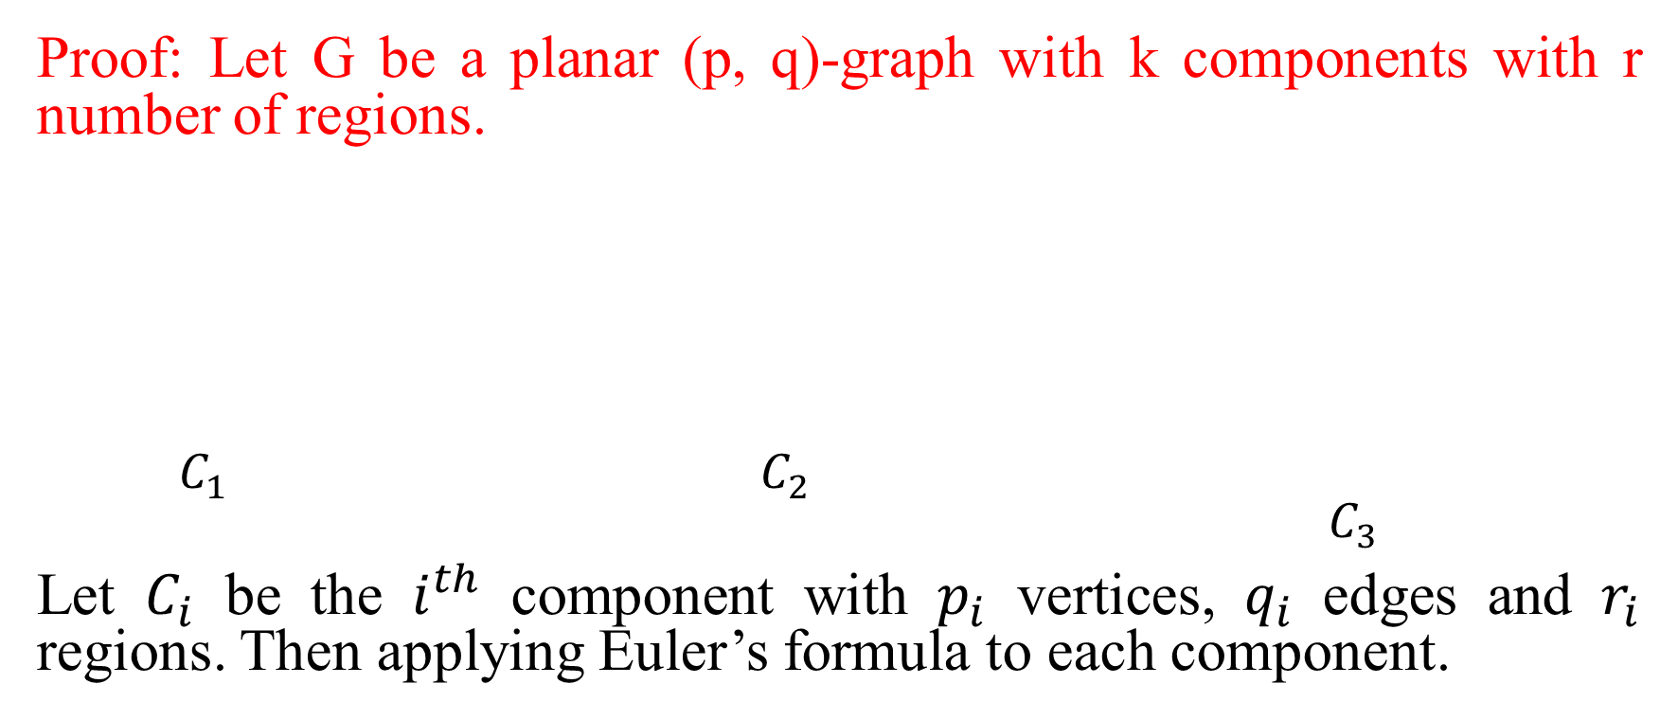
Theorem: Let G be a planar (p, q)-graph with k number of components with r regions then, p – q + r = k + 1
Proof: Let G be a planar (p, q)-graph with k components with r number of regions.
$C_{1}$ $C_{2}$ $C_{3}$
Let $C_{i}$ be the $i^{th}$ component with $p_{i}$ vertices, $q_{i}$ edges and $r_{i}$ regions. Then applying Euler’s formula to each component.

Slide 3
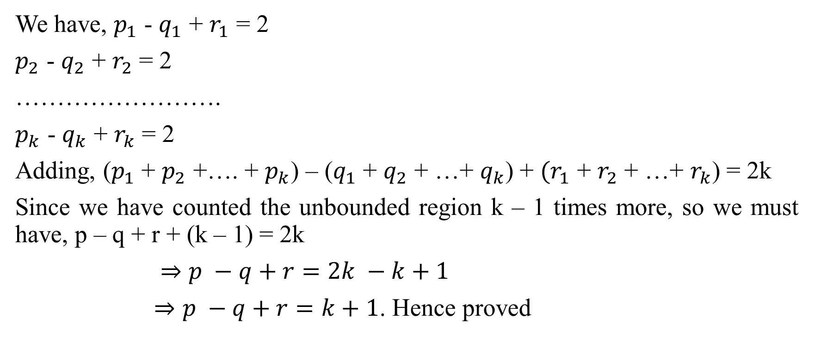
Continued….
We have, $p_{1}$ - $q_{1}$ + $r_{1}$ = 2
$p_{2}$ - $q_{2}$ + $r_{2}$ = 2
…………………….
$p_{k}$ - $q_{k}$ + $r_{k}$ = 2
Adding, ($p_{1}$ + $p_{2}$ +…. + $p_{k}$) – ($q_{1}$ + $q_{2}$ + …+ $q_{k}$) + $(r_{1}$ + $r_{2}$ + …+ $r_{k}$) = 2k
Since we have counted the unbounded region k – 1 times more, so we must have, p – q + r + (k – 1) = 2k
$⇒p −q+r=2k −k+1$
$⇒p −q+r=k+1$. Hence proved

Slide 4
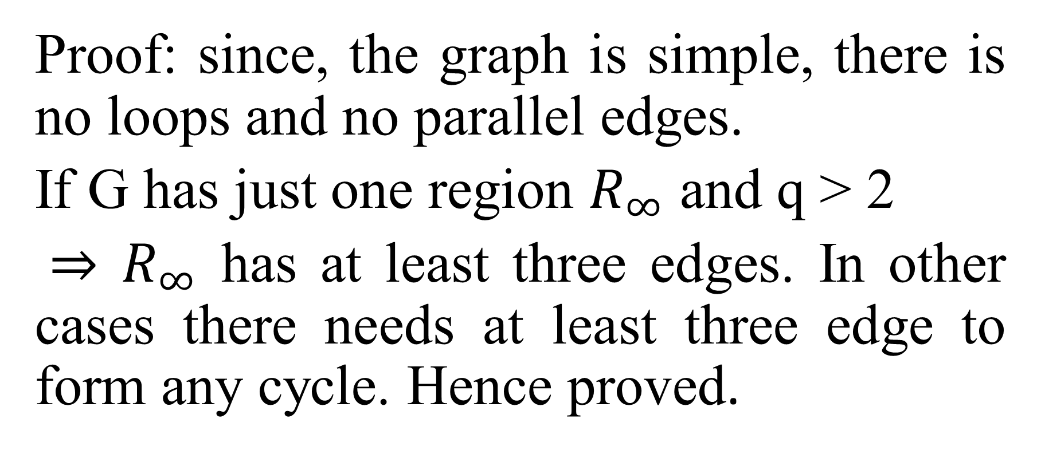
Theorem: let G be a (p, q)- simple graph and q > 2, then the boundary of any region contains at least three edges.
Proof: since, the graph is simple, there is no loops and no parallel edges.
If G has just one region $R_{∞}$ and q > 2
$⇒$ $R_{∞}$ has at least three edges. In other cases there needs at least three edge to form any cycle. Hence proved.

Slide 5
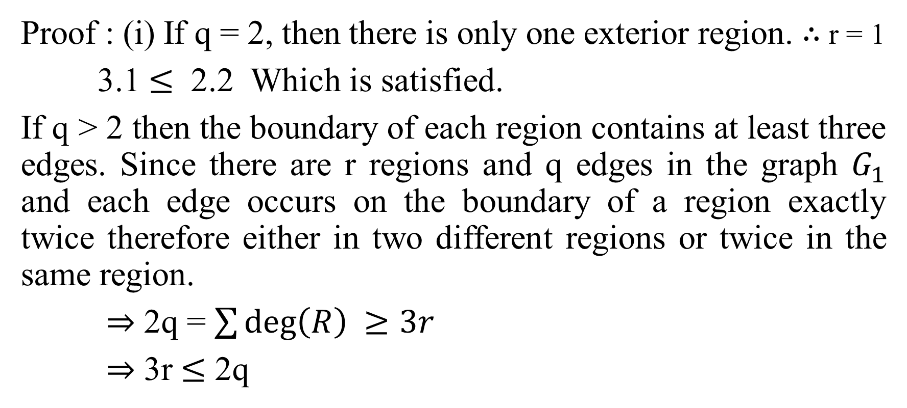
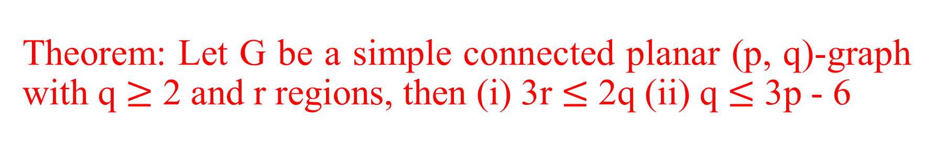
Theorem: Let G be a simple connected planar (p, q)-graph with q $≥$ 2 and r regions, then (i) 3r $≤$ 2q (ii) q $≤$ 3p - 6
Proof : (i) If q = 2, then there is only one exterior region. $∴$ r = 1
3.1 $≤$ 2.2 Which is satisfied.
If q > 2 then the boundary of each region contains at least three edges. Since there are r regions and q edges in the graph $G_{1}$ and each edge occurs on the boundary of a region exactly twice therefore either in two different regions or twice in the same region.
$⇒$ 2q = $\sum{\deg\left(R\right) ≥3r}$
$⇒$ 3r $≤$ 2q

Slide 6
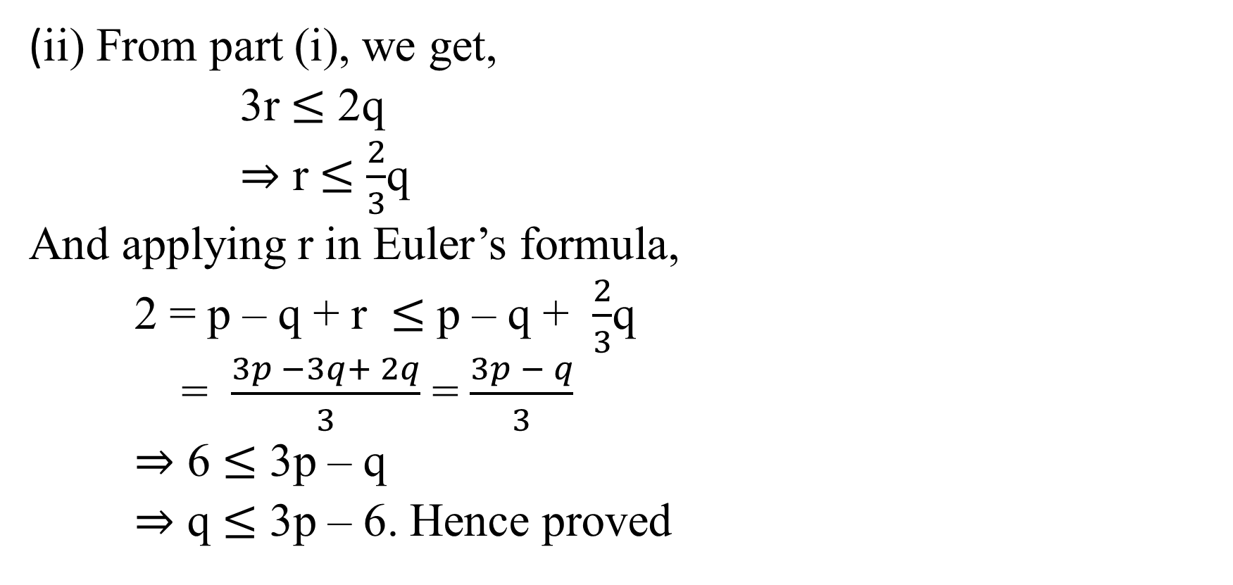
Continued…..
(ii) From part (i), we get,
3r $≤$ 2q
$⇒$ r $≤$ $\frac{2}{3}$q
And applying r in Euler’s formula,
2 = p – q + r $≤$ p – q + $\frac{2}{3}$q
= $\frac{3p −3q+ 2q}{3}$ = $\frac{3p − q}{3}$
$⇒$ 6 $≤$ 3p – q
$⇒$ q $≤$ 3p – 6. Hence proved

Slide 7
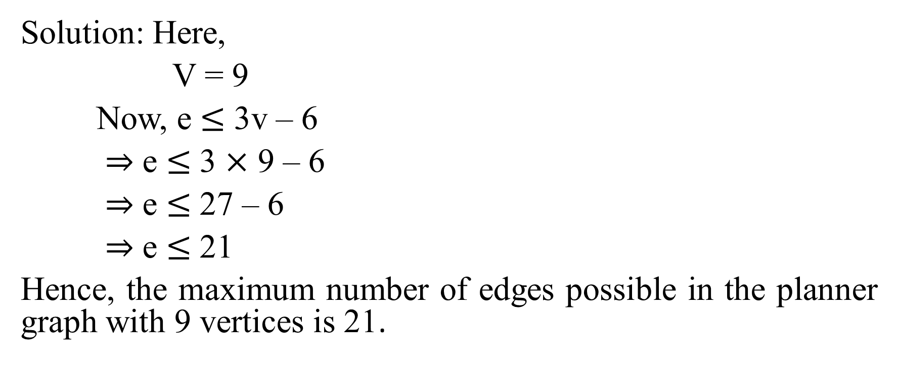
Find the maximum number of edges in the planar graph with 9 vertices ?
Solution: Here,
V = 9
Now, e $≤$ 3v – 6
$⇒$ e $≤$ 3 $×$ 9 – 6
$⇒$ e $≤$ 27 – 6
$⇒$ e $≤$ 21
Hence, the maximum number of edges possible in the planner graph with 9 vertices is 21.

Slide 8
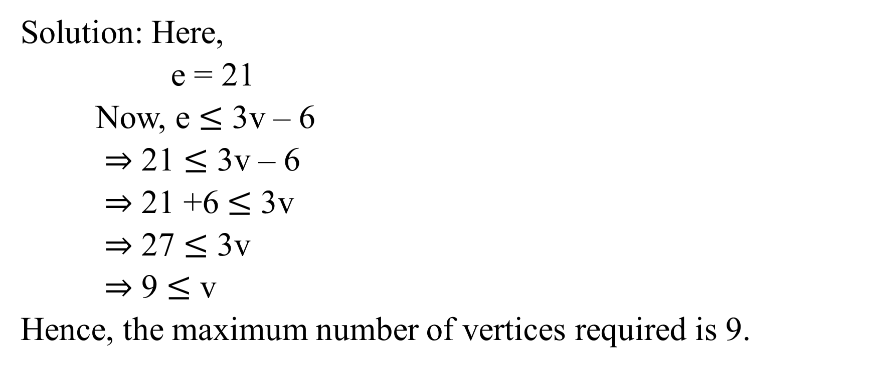
Find the maximum number of vertices necessary for a graph with 21 edges to be planar ?
Solution: Here,
e = 21
Now, e $≤$ 3v – 6
$⇒$ 21 $≤$ 3v – 6
$⇒$ 21 +6 $≤$ 3v
$⇒$ 27 $≤$ 3v
$⇒$ 9 $≤$ v
Hence, the maximum number of vertices required is 9.

Slide 9
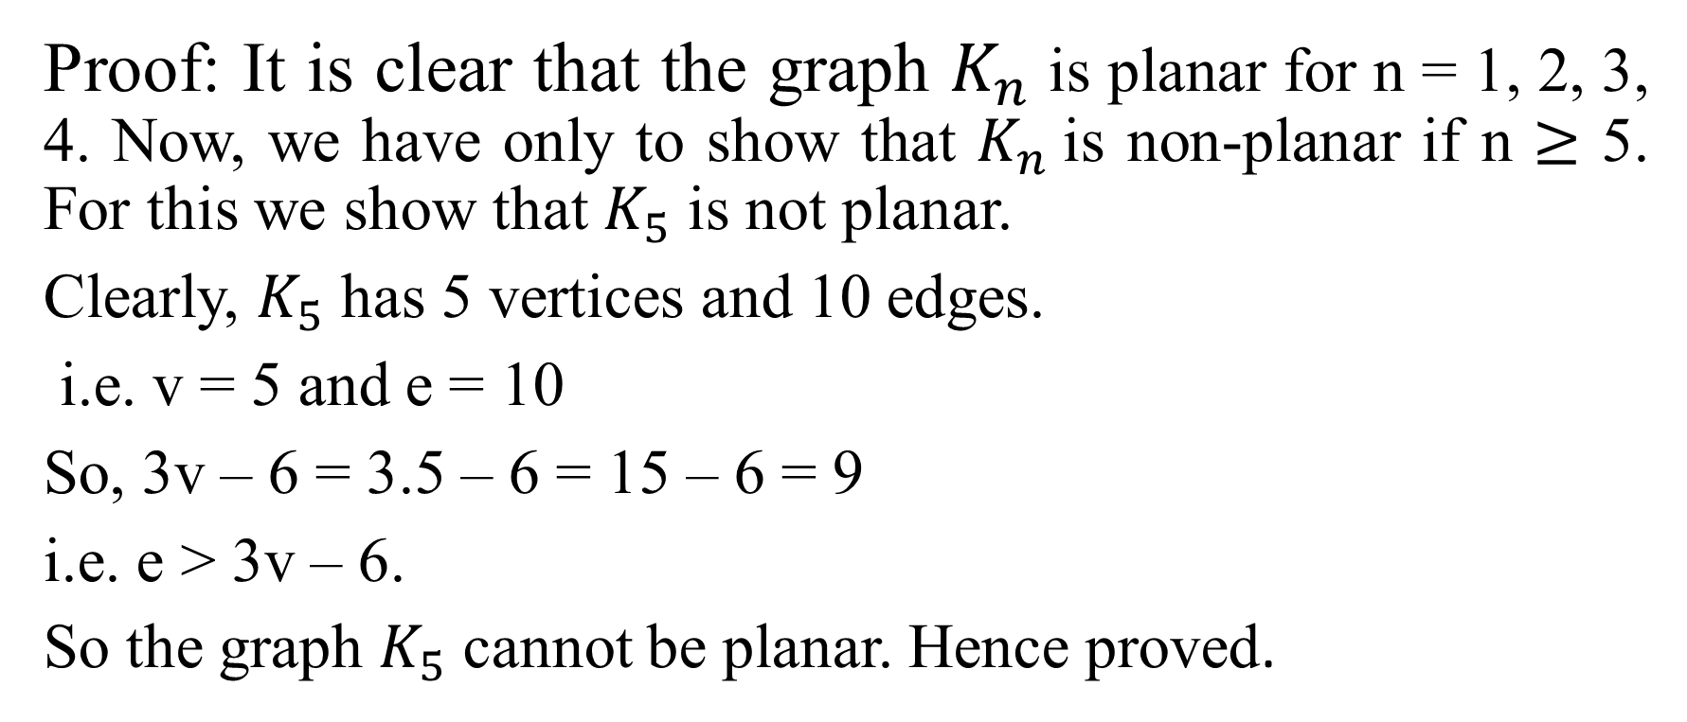
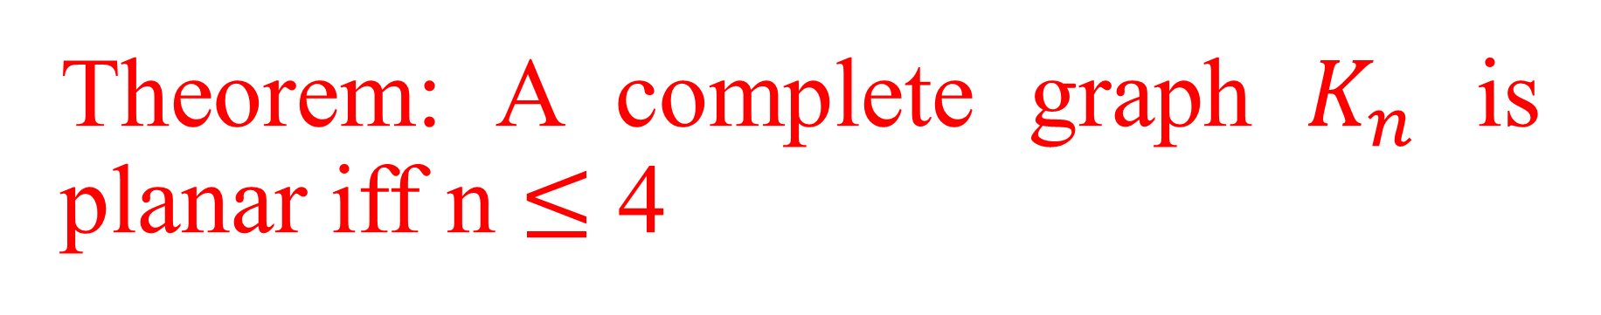
Theorem: A complete graph $K_{n}$ is planar iff n $≤$ 4
Proof: It is clear that the graph $K_{n}$ is planar for n = 1, 2, 3, 4. Now, we have only to show that $K_{n}$is non-planar if n $≥$ 5. For this we show that $K_{5}$ is not planar.
Clearly, $K_{5}$ has 5 vertices and 10 edges.
i.e. v = 5 and e = 10
So, 3v – 6 = 3.5 – 6 = 15 – 6 = 9
i.e. e > 3v – 6.
So the graph $K_{5}$ cannot be planar. Hence proved.

Slide 10
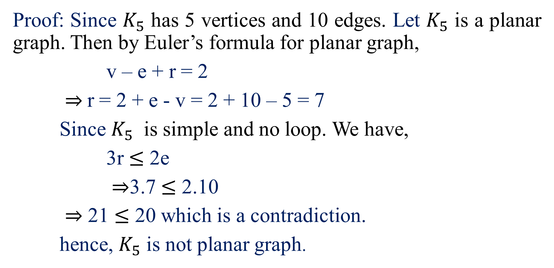

The graph $K_{5}$ is not planar.
Proof: Since $K_{5}$ has 5 vertices and 10 edges. Let $K_{5}$ is a planar graph. Then by Euler’s formula for planar graph,
v – e + r = 2
$⇒$r = 2 + e - v = 2 + 10 – 5 = 7
Since $K_{5}$ is simple and no loop. We have,
3r $≤$ 2e
$⇒$3.7 $≤$ 2.10
$⇒$ 21 $≤$ 20 which is a contradiction.
hence, $K_{5}$ is not planar graph.

Slide 11
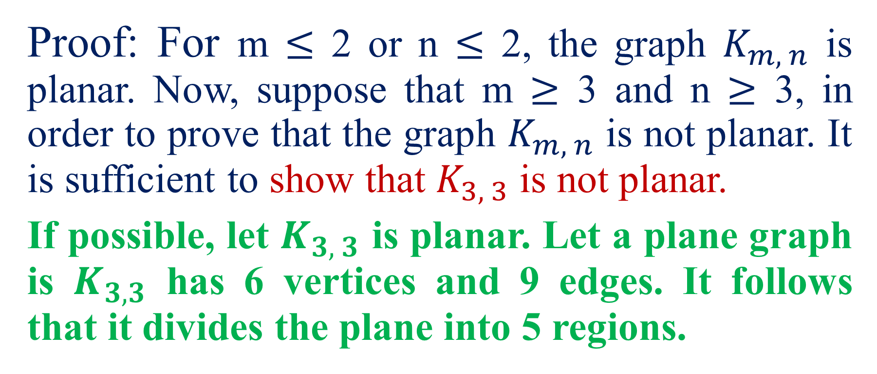
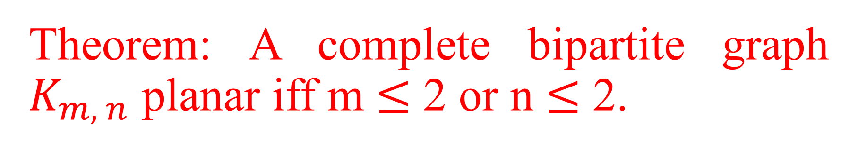
Theorem: A complete bipartite graph $K_{m, n}$ planar iff m $≤$ 2 or n $≤$ 2.
Proof: For m $≤$ 2 or n $≤$ 2, the graph $K_{m, n}$ is planar. Now, suppose that m $≥$ 3 and n $≥$ 3, in order to prove that the graph $K_{m, n}$ is not planar. It is sufficient to show that $K_{3, 3}$ is not planar.
If possible, let $K_{3, 3}$ is planar. Let a plane graph is $K_{3, 3}$ has 6 vertices and 9 edges. It follows that it divides the plane into 5 regions.

Slide 12
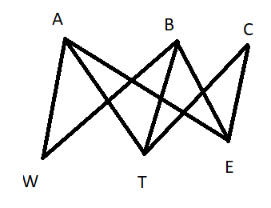
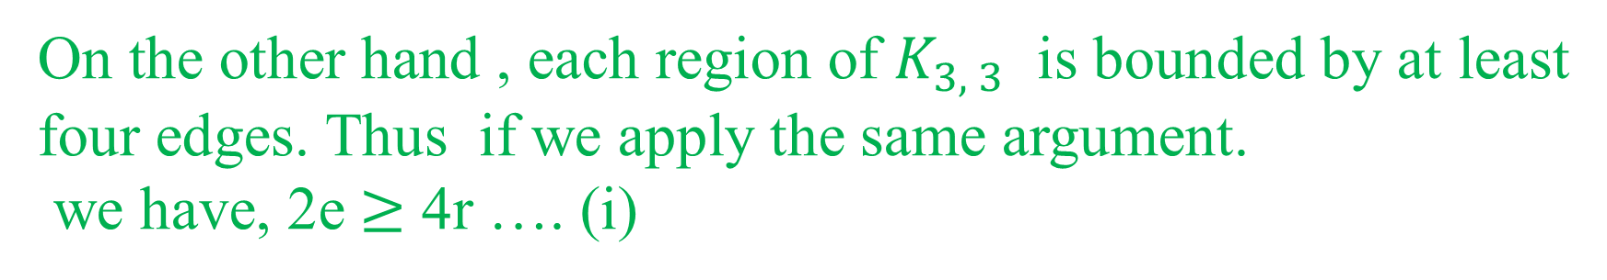
Continued……
On the other hand , each region of $K_{3, 3}$ is bounded by at least four edges. Thus if we apply the same argument.
we have, 2e $≥$ 4r …. (i)

Slide 13
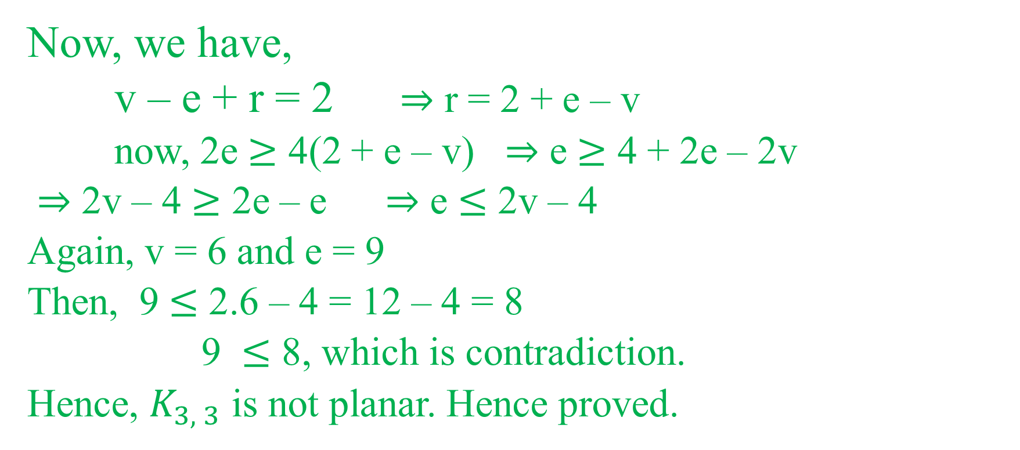
Continued…..
Now, we have,
v – e + r = 2 $⇒$ r = 2 + e – v
now, 2e $≥$ 4(2 + e – v) $⇒$ e $≥$ 4 + 2e – 2v
$⇒$ 2v – 4 $≥$ 2e – e $⇒$ e $≤$ 2v – 4
Again, v = 6 and e = 9
Then, 9 $≤$ 2.6 – 4 = 12 – 4 = 8
9 $≤$ 8, which is contradiction.
Hence, $K_{3, 3}$ is not planar. Hence proved.

Slide 14
Graph colouring
Vertex colouring:
A vertex colouring of a graph G is the assignment of colours to the vertices of G, one colour to each vertex, so that no two adjacent vertices have the same colour.
K-colourable:
A K-colouring of G is colouring of G using k-colours. If G has a colouring, then G is said to be k-colourable.

Slide 15
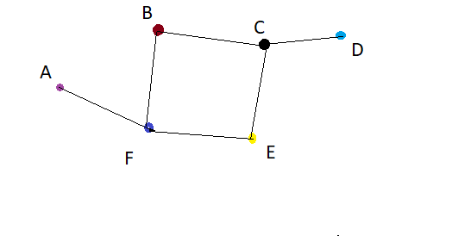
Continued…..

Slide 16
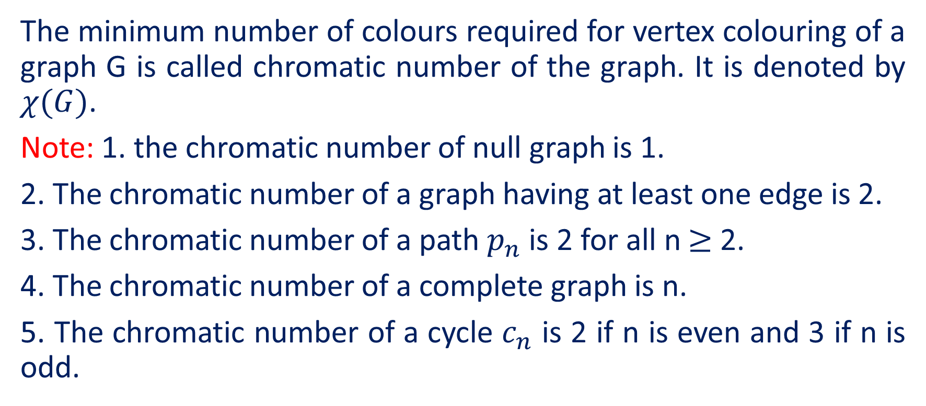
Chromatic number
The minimum number of colours required for vertex colouring of a graph G is called chromatic number of the graph. It is denoted by $χ(G)$.
Note: 1. the chromatic number of null graph is 1.
2. The chromatic number of a graph having at least one edge is 2.
3. The chromatic number of a path $p_{n}$ is 2 for all n $≥$ 2.
4. The chromatic number of a complete graph is n.
5. The chromatic number of a cycle $c_{n}$ is 2 if n is even and 3 if n is odd.

Slide 17


